Slide 1
Quality management in the National topographic database of Finland
Ulla Pyysalo, Quality KEN 25.4.2019.

Slide 2

Background
Project: The new national topographic database of Finland, 2015-2019, phase I
Workpackage; Quality management in the National topographic database of Finland
Group; Ulla Pyysalo, Teppo Ahonen, Jarmo Annunen, Hannu Villman, Antti Federley
Timetable 2019
Previous project NTDB data quality (2015-2016)
    Quality handbook for aerial images and orthophotos
    Quality handbook for laser scanning (3D point clouds)
    Quality handbook for digital elevation model (DEM)
Notes:
Syy, miksi esityksen aihe tämä, eikä conceptual models
Paketti alkanut vuoden vaihteessa
Sopii ryhmälle
Kysymyksiä ryhmälle

Slide 3
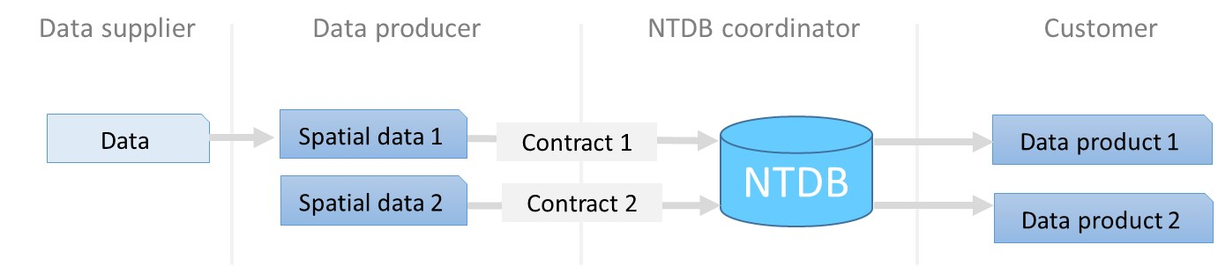

national topographic database of Finland, roles
Notes:
Consept and roles
Cordinator kerää aineistot, joita muut ylläpitävät
Data producer
Data supplier
NLS kaksoisrooli

Slide 4
questions
Who is responsible for quality management?
How do we share responsibility?
Can NTDB coordinator give quality promises for data collected by others?
1
Spatial data
Quality requirement
NTDB
Quality promise
2
Spatial data
Quality requirement
NTDB
No quality promise
3
Spatial data
No quality requirement
NTDB
No quality promise
4
Spatial data
No quality requirement
NTDB
Quality promise

Slide 5
Quality management
“Management activities and functions involved in determination of quality policy and its implementation through means such as quality planning and quality assurance.”
Quality design
Quality control
Quality assunrance
Quality improvement
24.4.2019
5
Notes:
Hoe to

Slide 6
Quality management
NTDB coordinator
Data producer
Quality design
Quality control
Quality assunrance
Quality improvement

Slide 7
Quality design
Quality design
“Quality design focuses on setting quality objectives and defining the operational processes and resources needed to achieve quality objectives.”
Done by the NTDB coordinator, ie NLS.
By setting quality the requirements and promises. The requirements are more tight than promises.
Writing Quality handbook for NTBD spatial data 2019.
  Data quality elements
  Quality measures
  Appendix: Quality Requirements and promises
  Appendix: Quality Rules

Slide 8




2019

Slide 9
Quality control
Quality control
“Quality control refers to that part of quality management that focuses on meeting quality requirements.”
These include for example
  Work instructions; NTDB coordinator provides conceptual models and formatting instructions.
  Competence, such as knowledge, skills, experience, and qualifications. Each data producer applies quality control in its own organization.

Slide 10
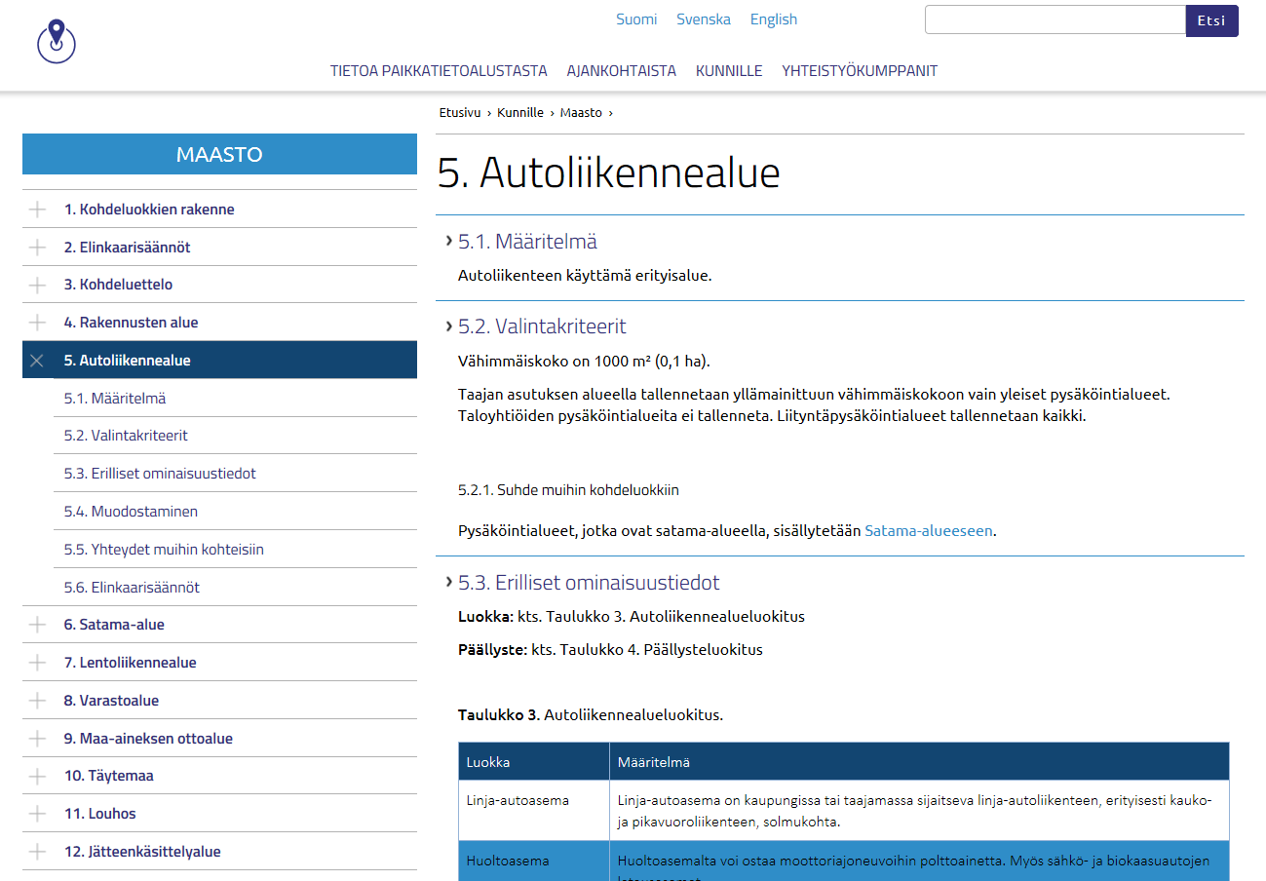

Slide 11
Quality assurance
Quality assurance
“Quality assurance is the part of quality management that focuses on giving confidence that quality requirements will be met. This is a practical quality work based on commonly agreed quality work practices and responsibilities.”
Divided between data producers and the NTDB coordinator.
Quality assurance is considered to include
  Quality tests and
  Data producer audits.

Slide 12
Quality test
NTDB co-ordinator
Measurable quality elements
Positional accuracy
Absolute or external accuracy,
XYZ
Data producer
Completeness
Omission
Comissiom
Thematic accuracy
Classification correctness
Non-quantitative attribute correctness
quantitative attribute accuracy
Temporal quality
Accuracy of a time measurement
Temporal consistency
Temporal validity
QualityGuard
Logical consistency
Conceptual consistency
Domain consistency
Format consistency
Topological consistency

Slide 13

“Towards Automating Spatial Data Quality Evaluation in the Finnish National Topographic Database”
SDQ 2018: International Workshop on Spatial Data Quality, Malta, Wednesday 7th February 2018
Nils Mesterton and Riikka Kivekäs, National Land Survey of Finland

Slide 14
What Shall…
NOT PASS
PASS
Invalid and empty geometries
Obligatory attributes
Overlapping buildings and building parts
Voidable attributes
Most issues regarding topological consistency
”Area in meters must be presented using the numeric data type”.

Slide 15
Data delivery process
Application
Audit process
Agreement
Data delivery
User license

Slide 16
Audit process
1. Questionnaire
- Data
- Process
- Quality management
- Commitment
2. Audit meeting
- Facilities: hardware, software
- Human resources
3. Report
- Decision (accepted/not accepted)
- Summary
- Development needs, measure proposals
4. Tracking meeting
- Commitment:
development needs, measure proposals fulfilled?

Slide 17
NLS Quality assurance
Quality assurance
Quality test by a consultant.
Demonstration of requirements specified in the NLS - Ministry of Agriculture and Forestry agreement.
  14 test fields Around Finland
  1x1 km for buildings
  3x3 km for roads and addresses
  Completeness (commission/omission) for buildings and roads
  Thematic accuracy for addresses (Municipalities official addressees compared to addressees in NLS GIS database)
  Field surveys <> data

Slide 18
Quality improvement
Quality improvement
“Improving quality means systematic harmonization and development of policies.”
  NTDB: QualityGuard reports
  Data producer: responding to the report, data correction.

Slide 19
summary
Quality design
Quality requirements
Quality promises
Quality control
Conceptual models
Formatting instructions
Competence, such as knowledge, skills, experience, and qualifications
NTDB coordinator
Data producer
Quality assurance
Quality test for logical consistency
QualityGuard-reports
Audit process
Quality test for completeness, thematic and positional accuracy
Quality improvement
Responding to the QualityGuard report, data correction.
24.4.2019
19

Slide 20
Thank you for attention

