Slide 1


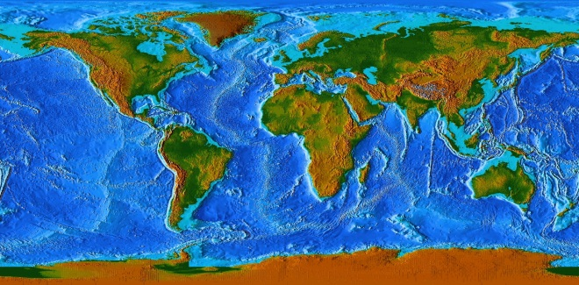




Challenges, Changes and Opportunities
The International Response - Global
Greg Scott, UN-GGIM Secretariat
Environmental Statistics and Geospatial Information Branch
United Nations Statistics Division
Department of Economic and Social Affairs
United Nations, New York
Positioning geospatial information to address global challenges

Slide 2
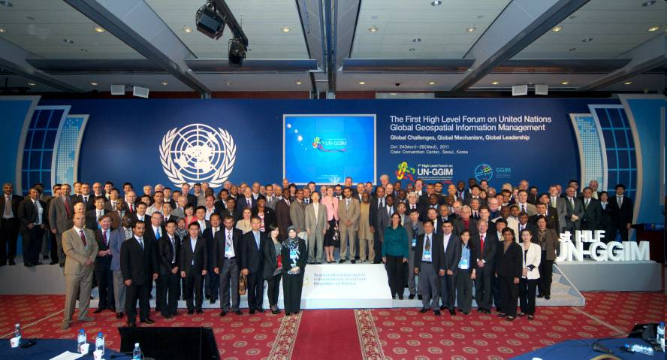



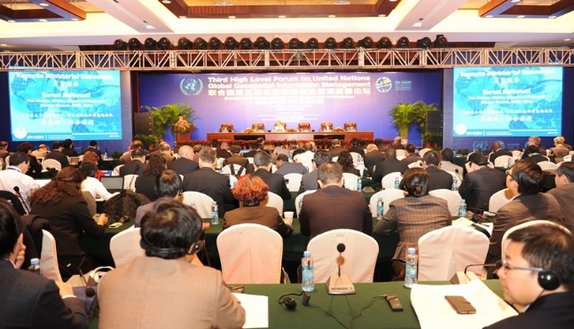
UN-GGIM
Positioning geospatial information to address global challenges
Established in 2011. Reports annually to ECOSOC.
An intergovernmental United Nations Committee of Experts to:
Discuss, enhance and coordinate global geospatial information management activities by involving Member States at the highest level.
Make joint decisions and set directions on the use of geospatial information within national, regional and global policy frameworks.
Address global issues and contribute collective knowledge as a community with shared interests and concerns.
Develop effective strategies to build geospatial capacity in developing countries.
Make accurate, reliable and authoritative geospatial information readily available to support national, regional and global development.
Positioning geospatial information to address global challenges

Slide 3
Challenges, Changes and Opportunities
The International Response - Global
The use of official (authoritative and reliable) geospatial information in the international context is very important to EuroGeographics, as it is to society.
The rich, detailed and authoritative nature of the data content is as important internationally and regionally as it is nationally.
However, the provision of national geospatial data, within the international context and the changing global landscape, creates some challenges.
What are the perspectives on these global developments and importance of authoritative data from the global UN perspective?
How can EuroGeographics contribute towards encouraging and enabling the use of national geospatial data to meet international, UN and other needs?
Positioning geospatial information to address global challenges

Slide 4

Challenges, Changes and Opportunities
Positioning geospatial information to address global challenges

Slide 5

The Sustainable Development Goals Report 2019
“It is abundantly clear that a much deeper, faster and more ambitious response is needed to unleash the social and economic transformation needed to achieve our 2030 goals. From our advances, we know what works. This report therefore highlights areas that can drive progress across all 17 SDGs: financing; resilience; sustainable and inclusive economies; more effective institutions; local action; better use of data; and harnessing science, technology and innovation with a greater focus on digital transformation. In everything we do, we must diligently ensure that policy choices leave no one behind, and that national efforts are supported by effective international cooperation, grounded in a commitment to diplomacy and crisis prevention”
António Guterres
Secretary-General, United Nations
Positioning geospatial information to address global challenges

Slide 6
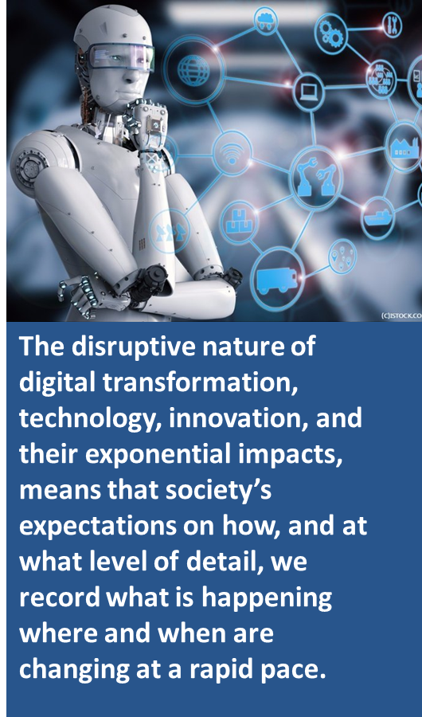
Challenges, Changes and Opportunities
Positioning geospatial information to address global challenges

Slide 7
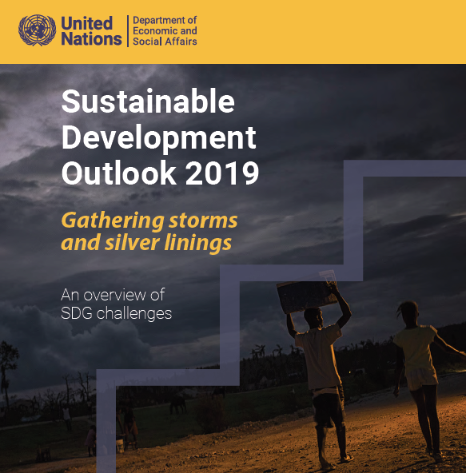
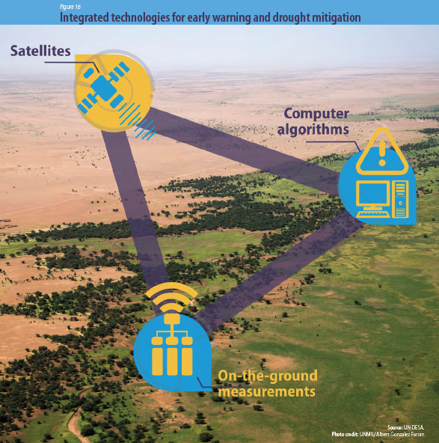
Positioning geospatial information to address global challenges

Slide 8
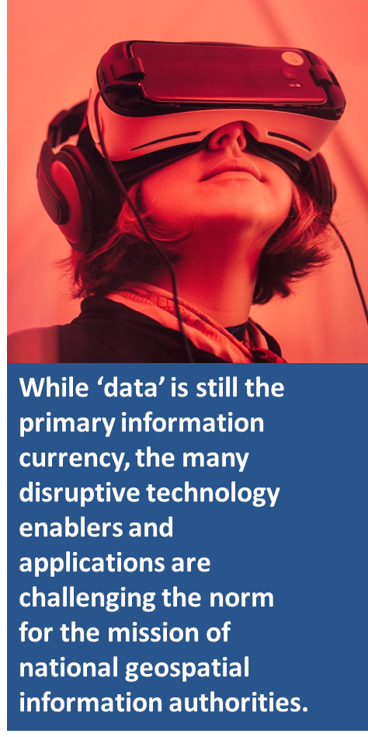
Challenges, Changes and Opportunities
Positioning geospatial information to address global challenges

Slide 9
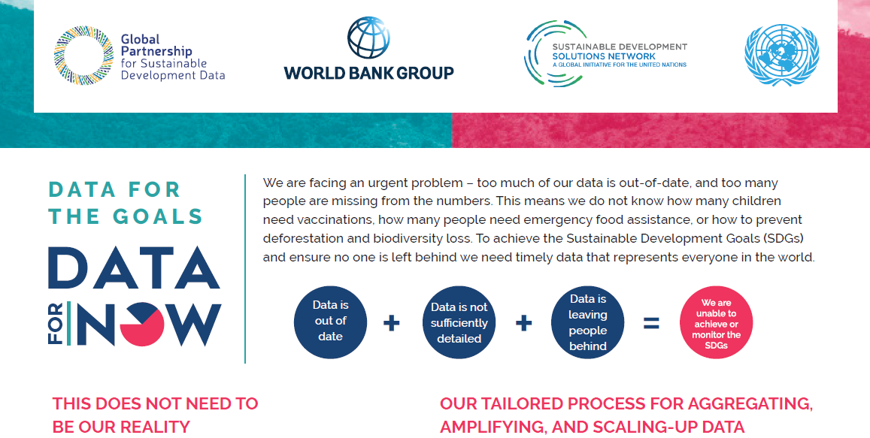
Positioning geospatial information to address global challenges

Slide 10
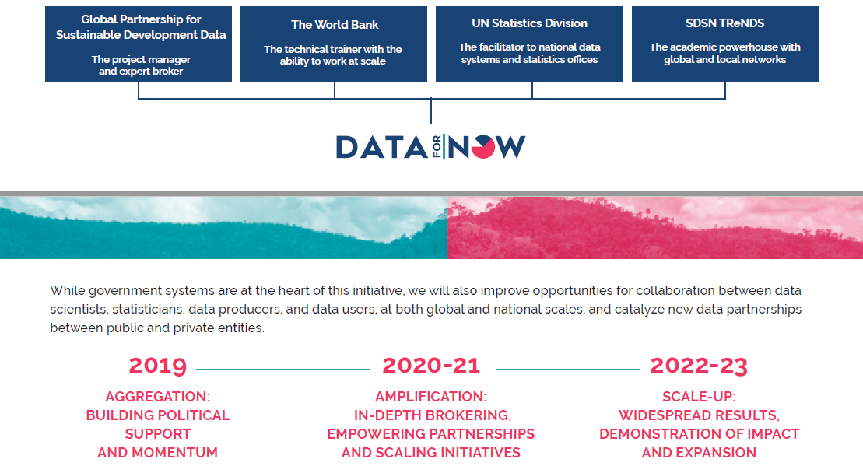
Positioning geospatial information to address global challenges

Slide 11
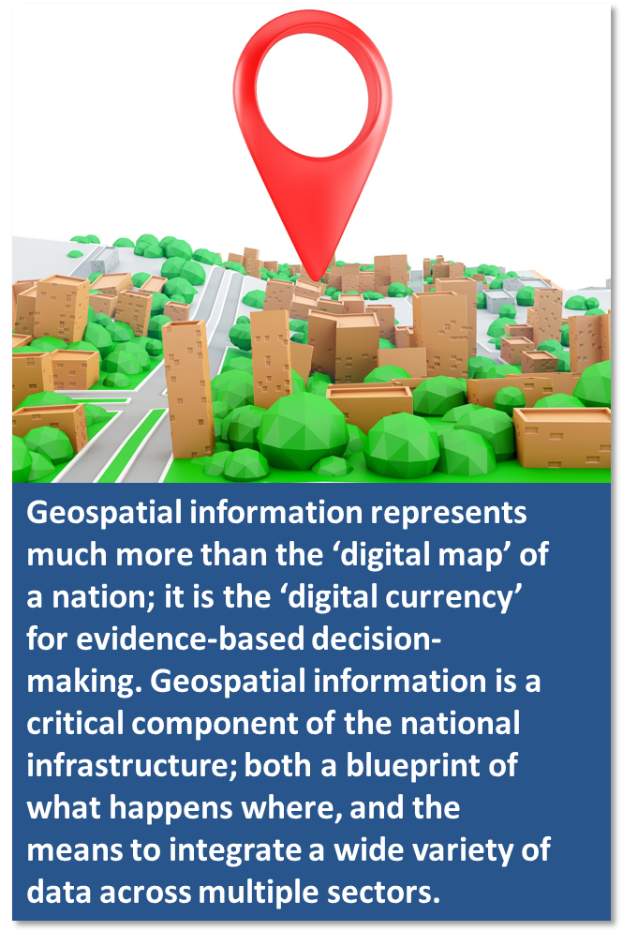
Challenges, Changes and Opportunities
Positioning geospatial information to address global challenges

Slide 12
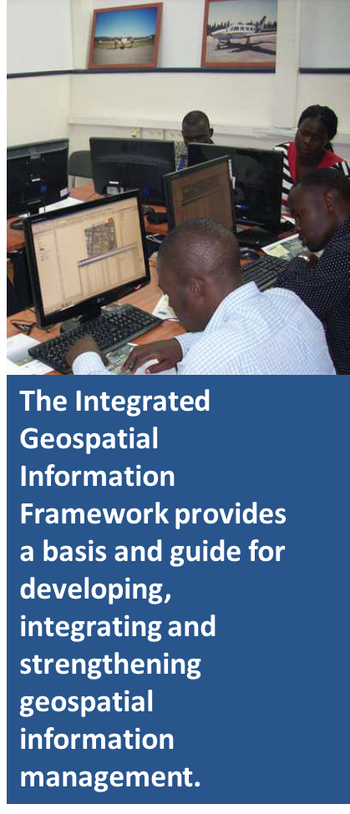
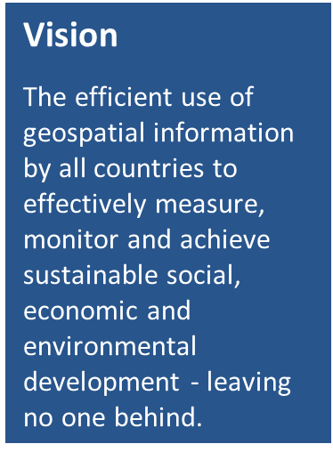
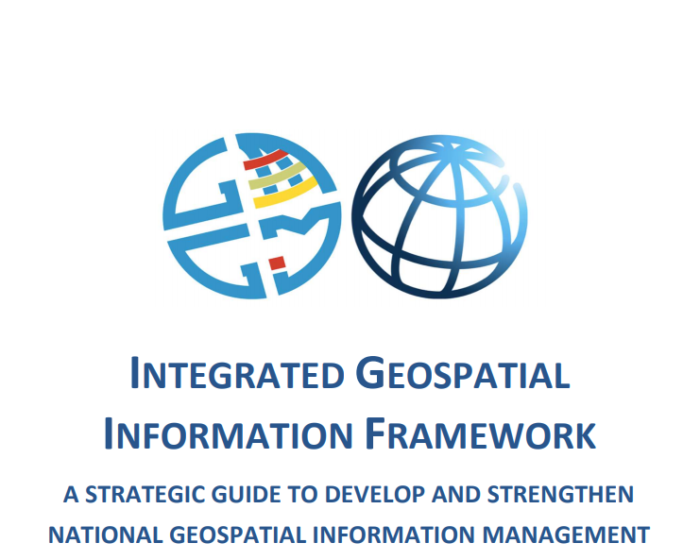
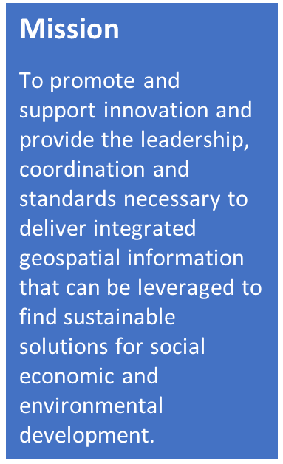
http://ggim.un.org/UN-GGIM-Intergrated-geospatial-information-framework/
Positioning geospatial information to address global challenges

Slide 13
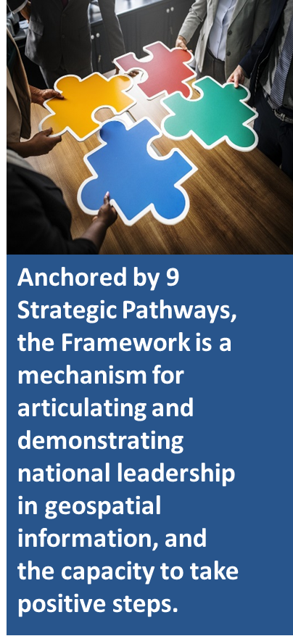
9 Strategic Pathways
Knowledge ▪ Decisions ▪ Development
Governance and Institutions
Policy and Legal
Governance
Financial
Technology
Data
Standards
Technology ▪ Applications ▪ Value
Innovation
Users ▪ Citizens ▪ Access
Capacity and Education
Communication
and
Engagement
People
Partnerships
Society ▪ Economy ▪ Environment
Positioning geospatial information to address global challenges

Slide 14
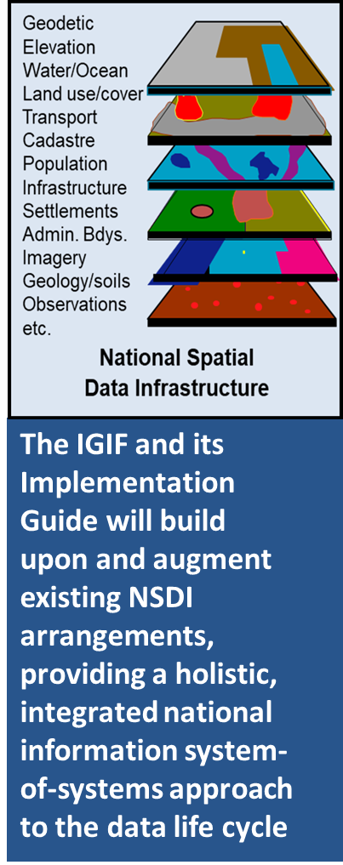
Challenges, Changes and Opportunities
Positioning geospatial information to address global challenges

Slide 15
Challenges, Changes and Opportunities
We function in times of disruption: rapidly increasing amounts of data, enabling technologies and associated analytics. New roles are emerging. New data is emerging!
What is changing rapidly is the pace at which high fidelity data is being made available… combined with enabling technologies and sophisticated analytics… that are able to collect and manipulate the data. How do we keep up?
Change itself is not the problem...it is the pace of change that is so challenging. How is our data responding to this pace… and the many multi-dimensional aspects?
New technologies that drive the collection, use and storage of data are increasing the relevance and quality of geospatial information.
Better and more relevant geospatial data is providing new information and knowledge about a range of sectors, increasing the potential, value and productivity of the data.
We need to be leading…not following! How do we do this as a community?
Positioning geospatial information to address global challenges

